Slide 1
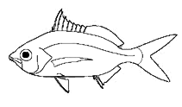
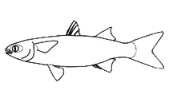
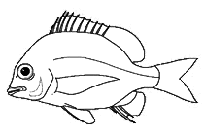

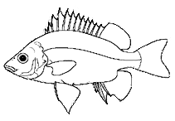
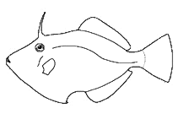
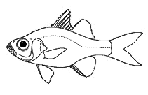
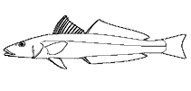
mojarras
mullets
porgies
halfbeaks
trumpeters
glassfish
filefish
smelt-whitings

Slide 2
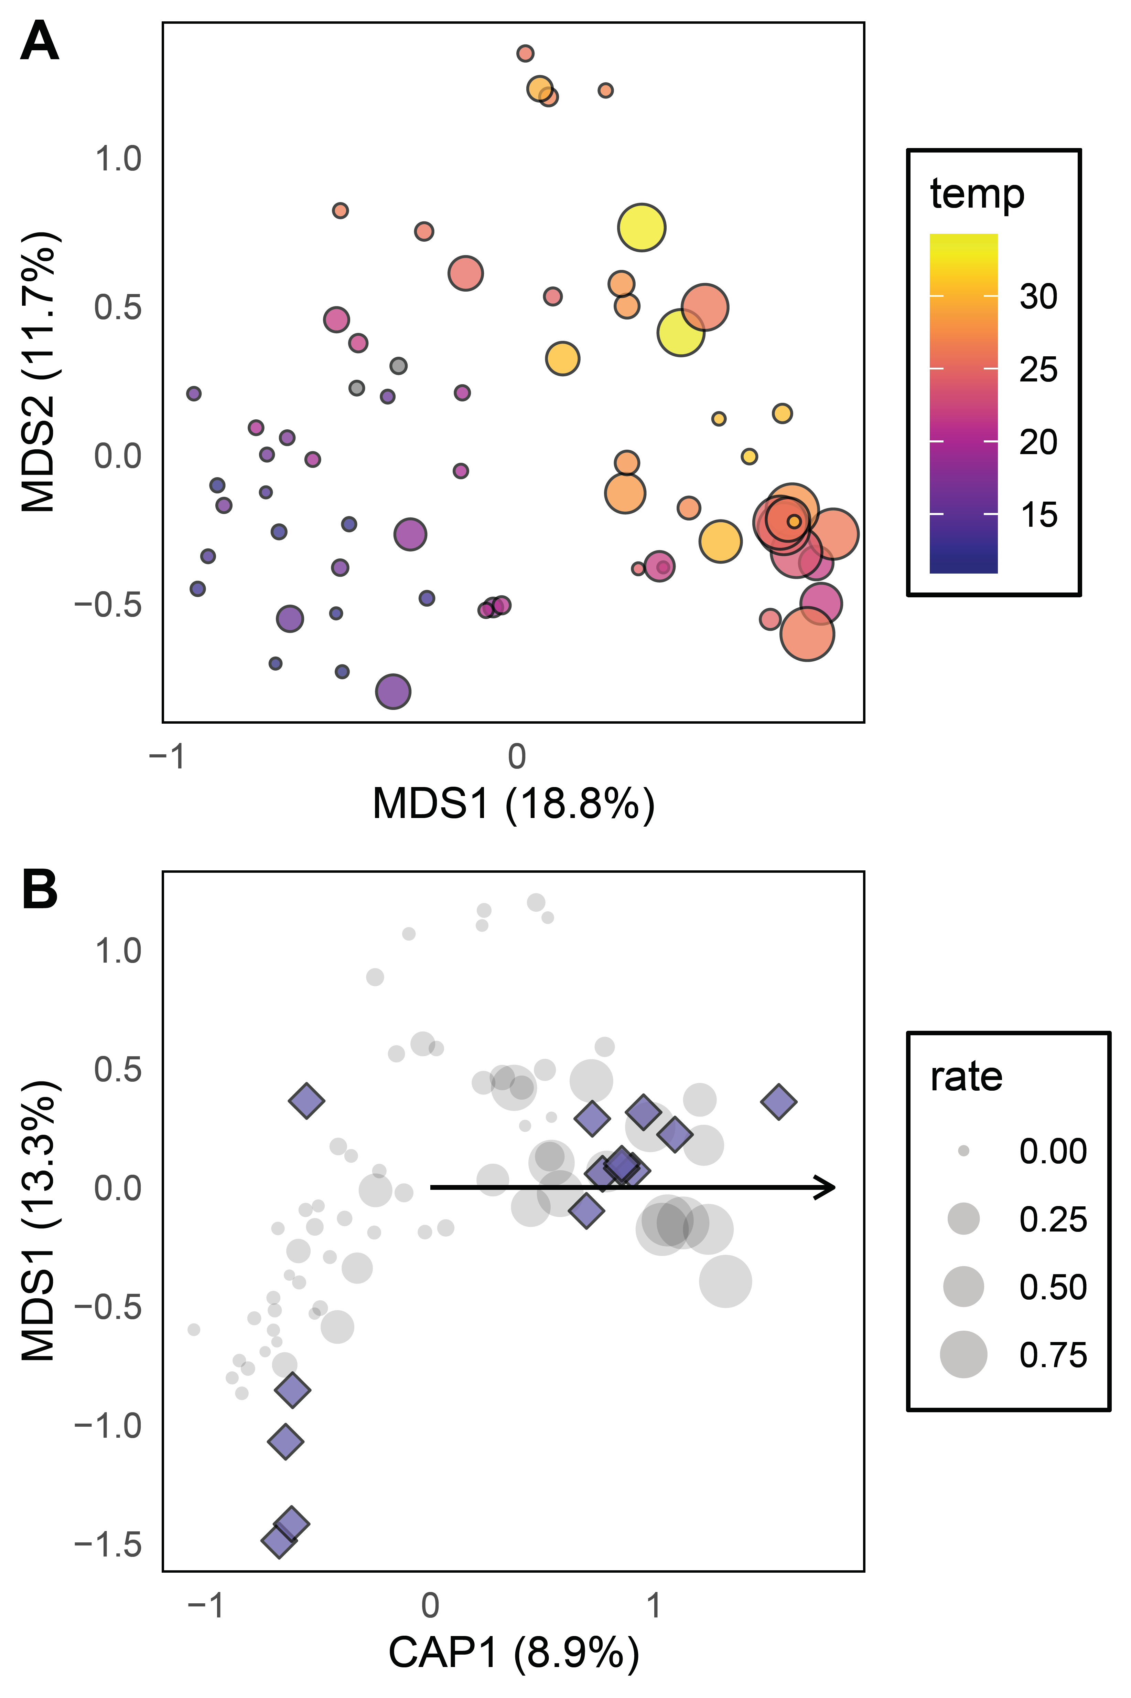
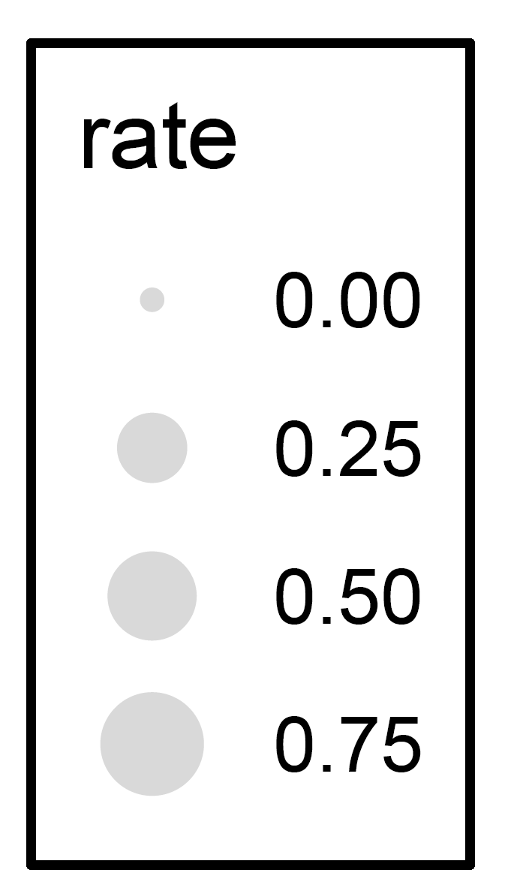
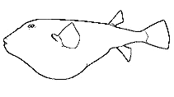
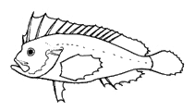
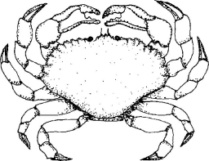
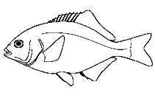
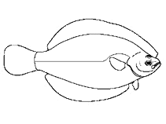
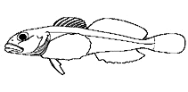
puffers
mullets
porgies
halfbeaks
rock crabs
waspfish
glassfish
filefish
grunters
surf perch
smelt-whitings
flounders
sculpins

Slide 3
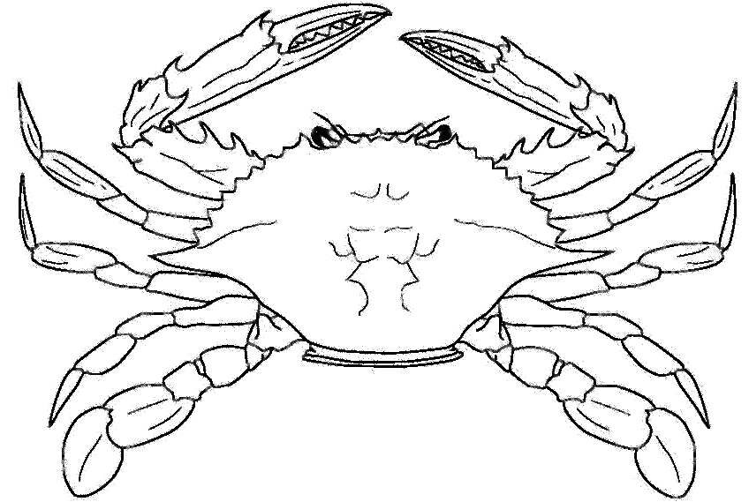

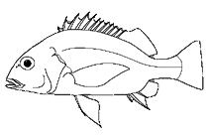

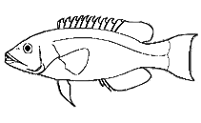

Neotropical
silverside
swimming
crab
mojarra
grunt*
surfperch
halfbeak*
porgy*
wrasse*
sculpin
puffer*
right-eye flounder
mullet
rock crab*
silverside

Slide 4
Neotropical
silverside
swimming
crab
mojarra
grunt*
surfperch
porgy*
halfbeak*
wrasse*
sculpin
puffer*
right-eye flounder
mullet
rock crab*
silverside

Slide 5
Neotropical
silverside
swimming
crab
mojarra
grunt*
surfperch
porgy*
halfbeak*
wrasse*
sculpin
puffer*
right-eye flounder
mullet
rock crab*
silverside

